Slide 1



Easy First Relation Extraction with Information Redundancy
马 帅

Slide 2

个人简介
北京航空航天大学计算机学院教授、博士生导师、大数据科学与工程国际联合研究中心主任；国家杰青；中国计算机学会数据库专业委员会常委，大数据专家委员会委员。
2011年作为海外优秀中青年人才加入北京航空航天大学计算机学院软件开发环境国家重点实验，并特聘为教授。
获得了北京大学(2004)和英国爱丁堡大学 (2011)的两个博士学位。英国爱丁堡大学博士后，并曾在美国贝尔实验室总部实习，在微软亚洲研究院访问。
Homepage: http://mashuai.buaa.edu.cn
Email: mashuai@buaa.edu.cn
Address: Room G1122,
New Main Building,
Beihang University

Slide 3




国家重点基础研究发展计划
网络信息空间大数据计算的基础研究(2014-2018)
Chief Scientist: Prof. Jinpeng Huai.
8 institutes involved
Focus on “computing theory and practice on Big Data”
http://cnbigdata.org/

Slide 4


北京市大数据科学与脑机智能创新中心
瓶颈1：计算的有效性遇到障碍
计算的有效性：
认识数据的内在特征，复杂网络、数学（统计）方法
瓶颈2：能耗成为突出问题
随着规模增大，调度复杂，计算系统功耗问题日益突出
传统存算分离的结构，产生大量的数据搬移开销
传统的计算和存储器件“功耗”不友好
瓶颈3：学习效率和灵活性
学习效率：需要大量的输入数据及标定数据，学习效率低
灵活性：普遍缺乏“类比、联想”等学习功能
数据科学与计算智能
数据工程与
脑机系统
新型计算技术与系统
认知机理与仿真
http://www.bdbc.org.cn/

Slide 5
大数据简介

Slide 6
大数据(维基百科)
[英文定义] Big data is the term for a collection of data sets so large and complex that it becomes difficult to process using on-hand database management tools or traditional data processing applications.
[中文定义]大数据或称巨量数据、海量数据、大资料，指的是所涉及的数据量规模巨大到无法通过人工，在合理时间内达到截取、管理、处理、并整理成为人类所能解读的信息[1][2]。
在总数据量相同的情况下，与个别分析独立的小型数据集相比，将各个小型数据集合并后进行分析可得出许多额外的信息和数据关系性，可用来察觉商业趋势、判定研究质量、避免疾病扩散、打击犯罪或测定实时交通路况等；这样的用途正是大型数据集盛行的原因[3][4][5]
[1]Kusnetzky, Dan. What is "Big Data?". ZDNet.
[2]Vance, Ashley. Start-Up Goes After Big Data With Hadoop Helper. New York Times Blog. 2010.
[3]Data, data everywhere. The Economist. [2010-02-25 ].
[4] Cat Casey and Alejandra Perez. E-Discovery Special Report: The Rising Tide of Nonlinear Review. Hudson Global. [1 July 2012 ]
[5]What Technology-Assisted Electronic Discovery Teaches Us About The Role Of Humans In Technology — Re-Humanizing Technology-Assisted Review. Forbes. [1 July 2012]
6

Slide 7
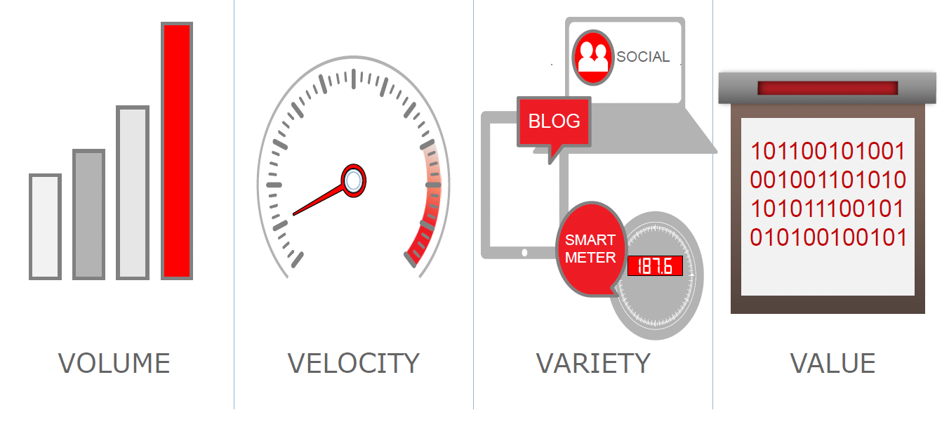
“大数据”特征 – 4V
规模大
变化快
种类杂
价值密度低
7

Slide 8
“大数据”溯源
2008年9月4日《Nature》刊登了一个名为“Big Data”的专辑
Researchers need to adapt their institutions and practices in response to torrents of new data — and need to complement smart science with smart searching. http://www.nature.com/news/specials/bigdata/
2009年10月微软为纪念Jim Gray, 出版了“第四范式—数据密集的科学发现 (The Fourth Paradigm — Data Intensive Scientific Discovery)
2011年2月11日：Science刊登了名为Dealing with Data的专辑，联合Science: Signaling、Science: Translational Medicine和Science Careers推出相关专题，讨论数据对科学研究的重要性
8

Slide 9
“大数据”溯源
2012年3月29日，美国总统科技政策办公室OSTP（Office of Science and Technology Policy）宣布了每年投资两亿美元的“大数据研究计划”（Big Data R&D Initiative）
同天，我国科技部发布的“‘十二五’国家科技计划信息技术领域2013年度备选项目征集指南”把“大数据研究”列在首位
9

Slide 10


“大数据”溯源
美国2016年5月发布《联邦大数据研究与开发战略计划》
其目标是对联邦机构的大数据相关项目和投资进行指导,主要围绕代表大数据研发关键领域的七个战略进行，包括促进人类对科学、医学和安全所有分支的认识;确保美国在研发领域继续发挥领导作用；通过研发来提高美国和世界解决紧迫社会和环境问题的能力。
“数据是一项有价值的国家资本，应对公众开放，而不是把其禁锢在政府体制。”
——美国联邦政府
10
http://www.thebigdata.cn/YeJieDongTai/30500.html

Slide 11
大数据成功案例

Slide 12

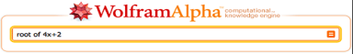

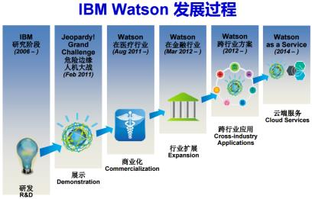
大数据的研究与应用：取得重大突破
过去8年大数据的研究，已经产生了重大突破，并在部分领域取得良好的应用
计算基础：大规模云计算、大规模深度学习
感知处理的角度：大规模深度学习，imageNet
知识组织与管理角度：大规模知识图谱
基于数据产生知识的问答系统与个人辅助系统
Watson DeepQA：智能搜索→知识引擎
Apple Siri & Wolfram Alpha
Watson和Wolfram|Alpha的成功说明：AI可以用一个纯粹的计算系统(交互+计算)实现

Slide 13

大数据的研究与应用1：IBM Watson

Slide 14
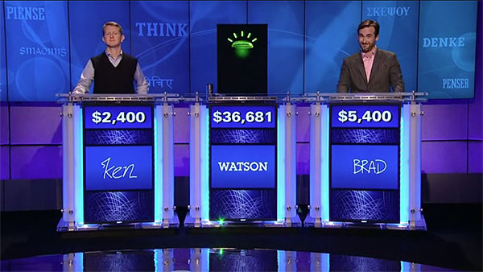
大数据的研究与应用1： IBM Watson
2011年2月11日，美国很受欢迎的智力竞答 “危险边缘（Jeopardy）”电视节目
IBM的“沃森”系统以绝对优势战胜两名人类顶级选手
和14年前的“深蓝”（战胜加里·卡斯帕罗夫）相比，“沃森”除具有超群的计算能力外，更拥有超大规模的数据以及数据处理能力

Slide 15

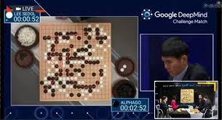
大数据的研究与应用2：Google AlphaGo
2016年3月的发生在韩国首尔的一场人机围棋比赛，Google AlphaGo对战世界顶级棋手李世石九段。
2016年3月9日、10日和12日的三局对战均为AlphaGo获胜，而13日的对战则为李世石获胜，15日的最终局则又是AlphaGo获胜。因此对弈结果为AlphaGo 4:1战胜了李世石
AlphaGo使用谷歌位于美国的云计算服务器，并通过光缆网络连接到韩国。

Slide 16
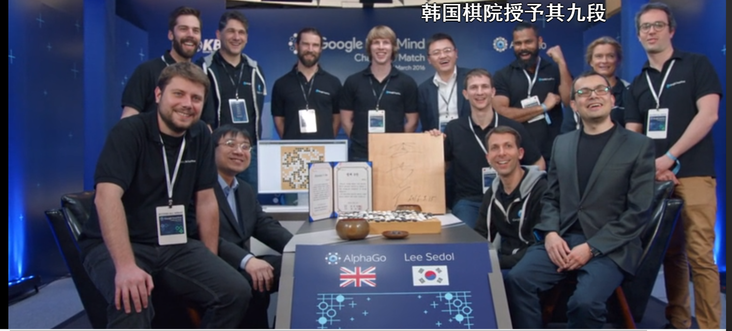
大数据的研究与应用： Google AlphaGo

Slide 17
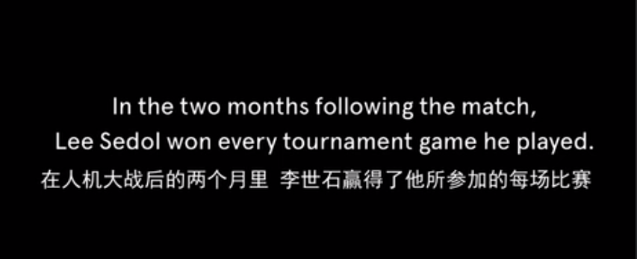
大数据的研究与应用： Google AlphaGo

Slide 18
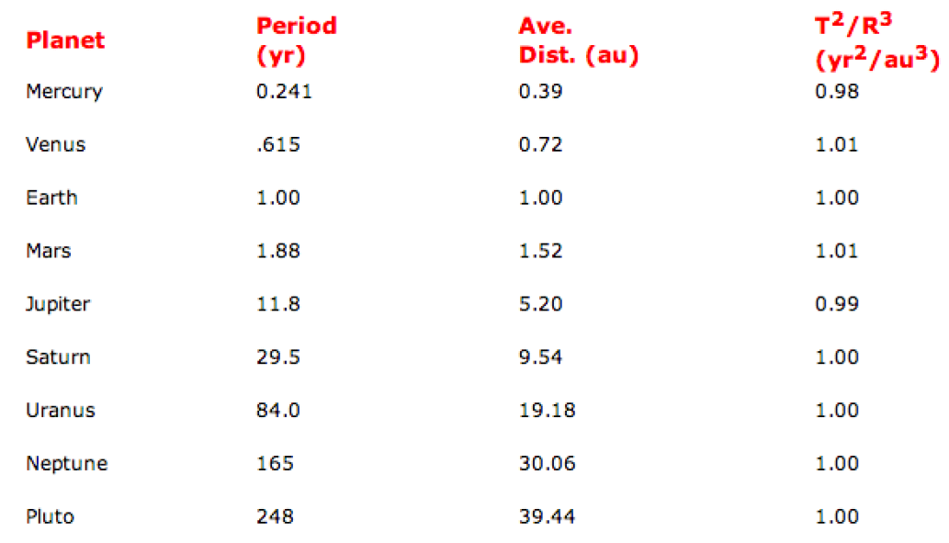
大数据的研究与应用3：开普勒第三定律
是以太阳为焦点的椭圆轨道运行的所有行星，其椭圆轨道半长轴的立方与周期的平方之比是一个常量。
18
Notes:
名丹麦天文学家第谷·布拉赫

Slide 19
大数据挑战示例

Slide 20




挑战：大数据的管理
回顾数据库领域的发展历程
1960s前后，外部存储设备问世，催生数据管理需求，数据库从文件系统中分离出来
1969年，具有完备理论的“关系数据模型”
1981年，事务处理，解决数据一致性问题
2000年以来，数据量持续增大带来的挑战
现代数据库概念和实践
-Ingres(查询改写)
-Postgres(对象关系模型)
-列存储、流处理
Michael Stonebraker
（2014年图灵奖）
具有完备理论的
关系数据模型
Edgar Frank Codd
（1981年图灵奖）
第三代RDBMS
大规模普及
IBM DB2
MS SQL Server
Oracle DB
（80年代后期）
1963
1969
1981
2014
第二代RDBMS:
IBM R系统
Ingres
（70年代）
Oracle DB
（1976）
海量数据存储与处理
GFS, MR, Bigdata
Spark, Impala, …
KV，列存储…
（2008--）
早期：网状数据库
集成数据存储（IDS）
Charles W.Bachman
（1973年图灵奖）
事务处理：解决一 致性与数据恢复问题
James Gray
（1998年图灵奖）

Slide 21
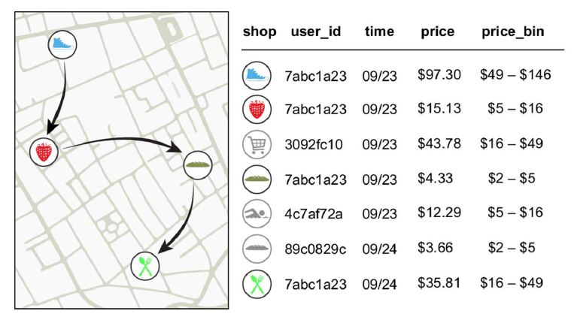
挑战：隐私保护
Yves-Alexandre de Montjoye, Laura Radaelli, Vivek Kumar Singh, Alex Pentland, Unique in the shopping mall: On the reidentifiability of credit card metadata,Science, Vol. 347, Issue 6221, pp. 536-539, 2015 (report).
Financial traces in a simply anonymized data set such as the one we use for this work.
Arrows represent the temporal sequence of transactions for user 7abc1a23..
Notes:
Traditional statistical problems could be
termed “large n, small p”: There were many
observations (n), such as participants in a
clinical trial, but few parameters were measured
(p), and just a handful of hypotheses
tested.

Slide 22
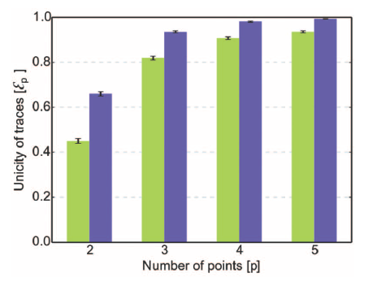
挑战：隐私保护
Yves-Alexandre de Montjoye, Laura Radaelli Vivek Kumar Singh, Alex Pentland, Unique in the shopping mall: On the reidentifiability of credit card metadata, Science, Vol. 347, Issue 6221, pp. 536-539, 2015 (report).
The unicity of the credit card data set given p points.
The green bars represent unicity when spatio-temporal tuples are known.
The blue bars represent unicity when using spatial-temporal-price triples
Large-scale data sets of human behavior have the potential to fundamentally transform the way we fight diseases, design cities, or perform research. Metadata, however, contain sensitive information.
We study 3 months of credit card records for 1.1 million people and show that four spatiotemporal points are enough to uniquely reidentify 90% of individuals.
Notes:
Traditional statistical problems could be
termed “large n, small p”: There were many
observations (n), such as participants in a
clinical trial, but few parameters were measured
(p), and just a handful of hypotheses
tested.

Slide 23



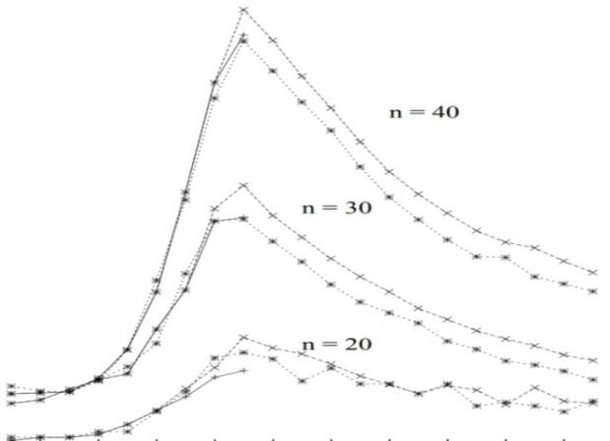
研究方向面临的机遇与挑战
23
国家大数据战略
与网络强国建设
联邦大数据战略
与美国情报战略
大数据产业推动
全球经济发展
普遍存在以难解易？难易实例的分离线？近似计算难解实例？
难解实例
任务感知
查询近似
大数据
近似
计算
数据感知
数据近似
新型存储
数据质量
易解
实例
易解
实例
Notes:
在已有研究基础上，我们针对普便存在的以难解易现象，深入分析了难解实例和易解实例的特性，猜想：在难易之间可能存在分离线，并思考了近似计算难解实例的可能性。
例如：结合任务感知、数据感知、新型存储，开展大数据近似计算研究。

Slide 24
关系抽取

Slide 25

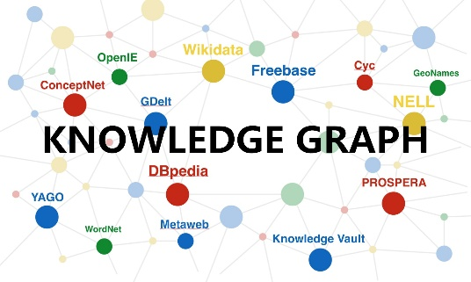

Easy First Relation Extraction
Relation Extraction (RE)
Crucial role for many knowledge based applications
Two types of relation extractors:
local (based on sentences) and global (based on corpora)
Global RE as a constrained optimization
Resolve conflict decisions
Utilize the dependencies among extracted facts
Be solved by mature optimization models
e.g. integer linear programming (ILP)
Notes:
As we know, Relation extraction (RE) has been extensively studied due to its crucial role for many knowledge based applications, such as question answering, knowledge graph, and recommender system.
There are two types of relation extractors: local and global. The former identify relationships between entity pairs individually according to the local features of sentences; The latter make decisions by further considering joint features of the entire corpus
Global relation extractors are able to resolve conflict decisions, and to utilize the dependencies among extracted facts to improve the performance, commonly by formalizing RE as a constrained optimization problem and solving RE with integer linear programming

Slide 26
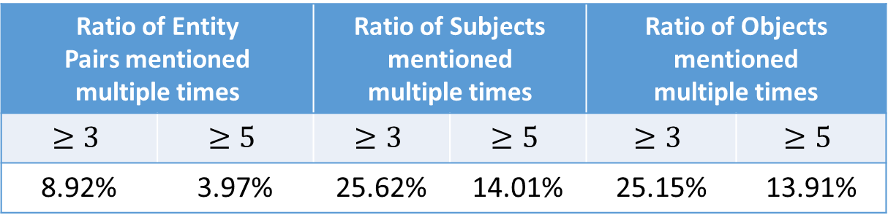
Easy First Relation Extraction
Challenges of Integer Linear Programming for RE
too much computing time and memory of ILP with voluminous variables and constraints
Redundant information are common, but needs to be encoded cautiously
#Mentions | #Entity Pairs | #Subjects | #Objects
53162 | 30864 | 11360 | 9709
Ratio of Entity Pairs mentioned multiple times |  | Ratio of Subjects mentioned multiple times |  | Ratio of Objects mentioned multiple times
8.92% | 3.97% | 25.62% | 14.01% | 25.15% | 13.91%
Redundancies Types
S-O redundancies; S-R redundancies;
O-R redundancies; R redundancies
Shuai Ma, Gang Wang, Yansong Feng, and Jinpeng Huai, Easy First Relation Extraction with Information Redundancy, EMNLP 2019.
Notes:
Using integer linear programming for RE as a blackbox solver is a challenging task.
First, with the increase of entity pairs and candidate relations, the variables and constraints encoded for ILP increase dramatically, which in return may consume too much computing time and memory.
Second, redundant information needs to be encoded cautiously.
For example, when we choose which city is the capital of Australia based on input data, the simple statistical methods, such as confidence summation, may easily lead to a wrong decision in this case.
So, A efficient and effective global relation extractor is neede.

Slide 27
Easy First Relation Extraction
Why Easy First Strategy?
Easy (most confident) decisions are accurate
Eliminate conflict candidates with constraints
Reduce the number of remaining variables to consider
Achieve precision and efficiency improvement
Relation Extraction Process
Traditional Methods
Easy First Method
All Candidates
Remaining Candidates
Constraints
Collective Inference
Constraints
Refined ILP
Integer Linear Programming
Redundancies
Easy Decisions
Hard Decisions
Decisions
Shuai Ma, Gang Wang, Yansong Feng, and Jinpeng Huai, Easy First Relation Extraction with Information Redundancy, EMNLP 2019.
Notes:
We propose an easy first approach for RE by making use of information redundancies
Why do we use easy first?
There are a lot of most confident decisions in the local results, and they are accurate
We make the easy decisions first and eliminate conflict candidates by constraints
It will exclude a lot of wrong candidates and the number of remaining candidates decrease greatly
The approach achieve precision and efficiency improvement
The process of the traditional approaches is that consider all candidates to make decisions by using ILP .
The easy first approach use redundancy to distinguish the easy decisions from all candidates. To remaining candidates, it use the ILP to find an optimal configuration

Slide 28
Outline
Redundancies and Constraints
Easy First Relation Extraction
Experimental Study
Notes:
Now, we show our work in details

Slide 29
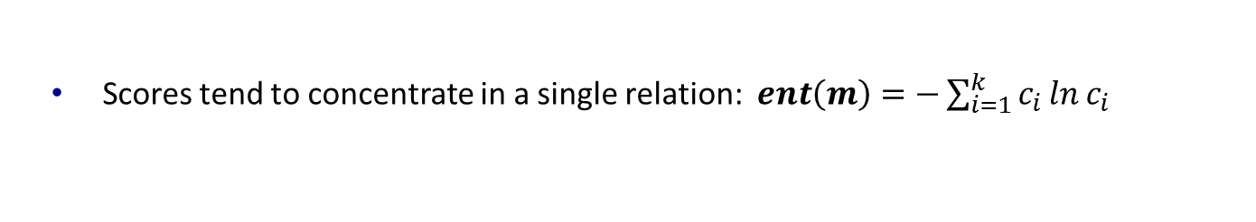
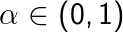

Redundancies for Easy Decisions
Characteristics of Easy Decisions
High certainty degree
Many repeated times
Most confident
Example of Local Results
 | Entity Pair (S, O) | Top-3 Candidate Relations (relation R: score C)
m₁ | Australia, Sydney | capital : 0.6 | birthPlace : 0.35 | nationality : 0.05
m₂ | Australia, Sydney | capital : 0.7 | country : 0.23 | birthPlace : 0.07
m₃ | Australia, Canberra | capital : 0.96 | birthPlace : 0.03 | unknown : 0.01
RC
0.18
0.57
Certainty Degree
(1) S-O Redundancy for Distinguishing Easy Decisions
Consider certainty degree and repeated times of mentions with
enforce that the more certain, the greater sum
same<subject, object, top-one relation>: $RC\left(s, r_{1}, o\right)=\sum_{m^{′}∈M_{s, o, r_{1}}}{α^{ent\left(m^{′}\right)}}$
Notes:
Easy Decisions have two characteristics: high certainty degree and many repeated times.
Let’s see a example
Each row is a mention, it corresponds a sentence in the corpus. It has subject, object and some candidate relations with scores
We define certainty degree to evaluate whether scores tend to concentrate in a single relation
To distinguish easy decisions, we consider both certainty degree and repeated times of mentions with same tuple
Alpha is a small positive number to enforce that the more certain, the greater redundancy score we can obtain
From the example, Canberra as the capital of Australia is more confident

Slide 30

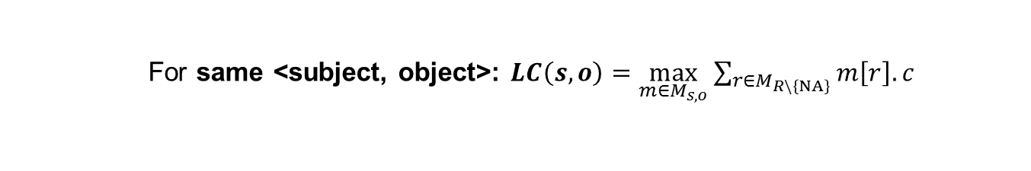
Redundancies for Easy Decisions
 | Entity Pair (S, O) | Top-3 Candidate Relations (relation R: score C)
m₁ | Australia, Sydney | capital : 0.6 | birthPlace : 0.35 | nationality : 0.05
m₂ | Australia, Sydney | capital : 0.7 | country : 0.23 | birthPlace : 0.07
m₃ | Australia, Canberra | capital : 0.96 | birthPlace : 0.03 | unknown : 0.01
(2&3) S-R and O-R redundancies
Whether a subject (or an object) meets the domain requirement of a relation
E.g. 𝑳𝑪(Australia, capital) > 𝑳𝑪(Australia, birthPlace) means
“Australia” tend to be the subject of capital rather than birthPlace
For same <subject, relation>: $LC\left(s,r\right)=\frac{\sum_{m∈M_{s}}{m\left[r\right].c}}{\sum_{m∈M_{s}}{\sum_{r^{′}∈R\backslash \left\{NA\right\}}{m\left[r\right].c}}}$
(4) R redundancies
Whether a subject and an object have a non-unknown relation
For same <subject, object>: $LC\left(s, o\right)=\max_{m∈M_{s, o}}{\sum_{r∈M_{R\backslash \left\{NA\right\}}}{m\left[r\right].c}}$
Notes:
We also find other redundancies
S-R and O-R redundancies evaluate whether a subject (or an object) meets the domain requirement of a relation. When computing the likelihood score, we use the scores of the same subjects and relations
For example, “Australia” tend to be the subject of capital rather than birthplace, the subject domain of capital and birthplace are country and person respectively
Finally, R redundancies evaluate whether a subject and an object have a relation. The Likelihood score selects prominent information to measure the probability
For example, there is a high probability of a relation between Australia and Canberra

Slide 31
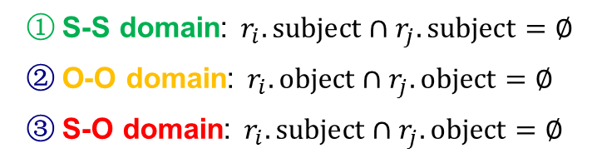
Redundancies for Easy Decisions
Domain Constraints
Enforce constraints among the subject and object domains of relations.
Subject Domain | Relation | Object Domain
Countries | largestCity | Cities
Organizations | locationCity | Cities
Persons | nationality | Countries
S-S domain: $r_{i}.subject∩r_{j}.subject=∅$
O-O domain: $r_{i}.object∩r_{j}.object=∅$
S-O domain: $r_{i}.subject∩r_{j}.object=∅$
Uniqueness Constraints
Enforce the uniqueness of the subjects and objects of relations.
O (S) uniqueness: Given a object (or an object), the relation should have unique subjects (or objects)
Subject Domain | Relation | Object Domain
Persons | birthPlace | Cities
Countries | capital | Cities
Notes:
Now, we introduce the constraints
S-S domain constraint ensures the subjects of two relations with this constraints belong to different domain, that is, the subjects of two relations are disjoint
For example, it ensure relations largestCity and locationCity share no common entities between their subjects
O-O and S-O domain constraints have similar definition
For Uniqueness constraints, if a relation has O uniqueness constraints, given a object, it should have unique subjects
For example, relation capital has O uniqueness, because a city can be capital of only one country.

Slide 32
Outline
Redundancies and Constraints
Easy First Relation Extraction Framework
Experimental Study
Notes:
Next, we show the experimental study

Slide 33
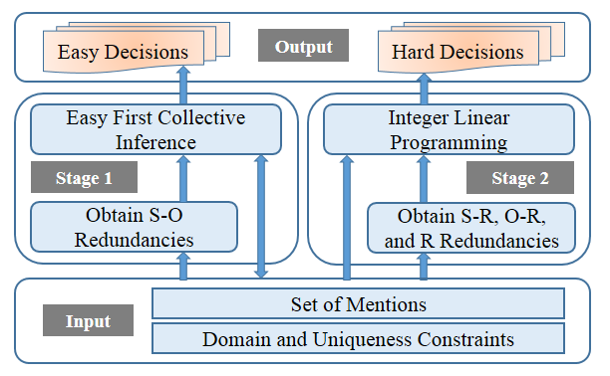
Easy First RE Framework
Stage 1: Easy First Collective Inference
Utilize S-O redundancies
Make easy (most confident) decisions
Stage 2: Integer Linear Programming
Utilize S-R, O-R, and R redundancies
Make hard decisions with ILP
Notes:
First, our approach obtains S-O redundancies, and makes easy decisions with collective inference in the first stage.
Then it obtains other three redundancies, and makes hard decisions with ILP in the second stage.

Slide 34
Stage 1: Easy First Collective Inference
A set M of mentions produced by local extractor
1. Compute S-O redundancy scores for each <subject, object, top-one relation>
2. Sort tuples in descending order of the scores, and store them in a max-heap
To avoid error propagation, using the top-one relations of mentions only
The highest redundancy score is greater than 𝜖
1. Put the candidate with the highest redundancy score into the decisions set
Threshold 𝜖 distinguish easy decisions from hard ones based on S-O redundancies
2. Remove the conflict candidates directly based
on domain and uniqueness constraints
Stage 1 greatly reduces the variables and constraints encoded in the ILP
Easy Decisions E
Notes:
First, It computes the S-O redundancy scores for all tuples.
In the first stage, easy decisions must be highly accurate to avoid error propagation. So we consider the top-one relations only.
In the loop, we first put the candidate with the highest score into the decisions set
Once a decision is made, disagreements are resolved immediately with domain and uniqueness constraints directly
The above process is repeated until the highest score in the max-heap is less than a threshold (/'epsɪlɒn/), which is to ensure the correctness of decisions.
Stage 1 greatly reduces the variables and constraints encoded in the ILP

Slide 35
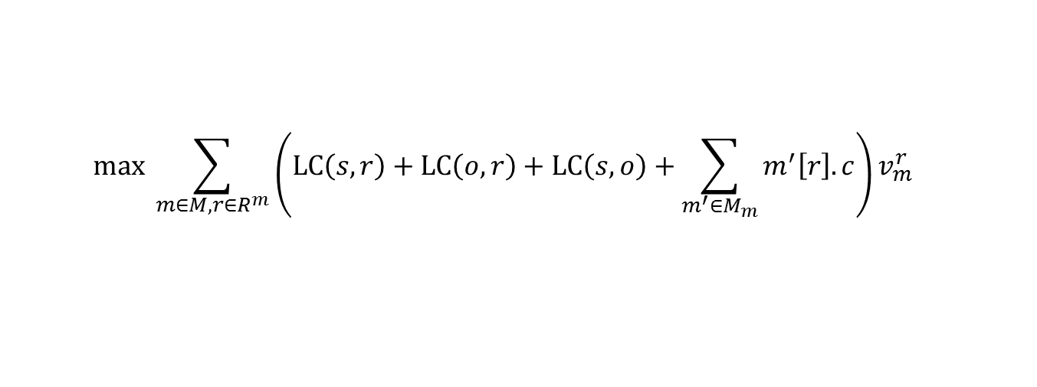
Stage 2: Integer Linear Programming
Hard Decisions Making
Find an optimal configuration for the remaining candidates
Utilize S-R, O-R, and R redundancies
Solve the disagreements by domain and uniqueness constraints
Adopt the ILP tool “IBM ILOG CPLEX”
Objective Function
Maximize the overall confidence of the made decisions
$$max \sum_{m∈M, r∈R^{m}}{\left(LC\left(s, r\right)+LC\left(o, r\right)+LC\left(s, o\right)+\sum_{m^{′}∈M_{m}}{m^{′}\left[r\right].c}\right)v_{m}^{r}}$$
①
②
① Encourage to select candidates meeting the domain requirements of relations
② Consider decisions produced by local extractors.
Notes:
In the second stage, our goal is to find an optimal configuration for the remaining candidates, making use of other three redundancies, solving the disagreements by domain and uniqueness constraints encoded in ILP, we use CPLEX to solve it
For each candidate, the objective function consists of two parts: The former is designed to encourage the model to select candidates meeting the domain requirements of relations, and the latter is designed to give consideration to decisions produced by local extractors.

Slide 36
Outline
Redundancies and Constraints
Easy First Relation Extraction Framework
Experimental Study
Notes:
Next, we show the experimental study

Slide 37
Experimental Setups
Datasets
Corpora | Datasets | Sentence level local extractors | Relations | Mentions | Mentions with unknown
DBpedia | DB_me | MaxEnt [ACL’ 14] | 51 | 53162 | 38654
 | DB_nn | NN [ACL’ 16]
Algorithms
eFIRE (Ours) | The easy FIrst approach for Relation Extraction with information redundancies
baseline | ILP based global method for RE [ACL’ 14]
CNN+ATT | Neural network-based methods with attention mechanism to use all informative sentences [ACL’ 16]
PCNN+ATT
Parameters: $α=0.05$,$ε=0.8$
Implementation: 2 Intel Xeon 2.6GHz CPUs and 64 GB of memory
Notes:
1. All experiments are conducted on two datasets.
2. We compare our approach with the popular and the state-of-the-art solutions.

Slide 38
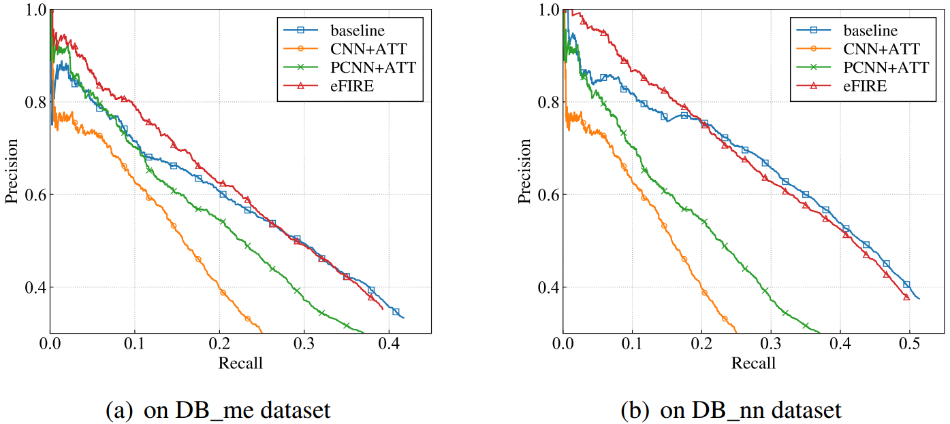
Overall performance: Effectiveness
Improve over the comparison methods in the low recall portion [0, 0.25]
Datasets | baseline | CNN+ATT | PCNN+ATT
DB_me | 4.80%↑ | 17.99%↑ | 7.69%↑
DB_nn | 4.36%↑ | 28.10%↑ | 17.82%↑
Notes:
For effectiveness, we use Precision-Recall Curve to measure.
Our approach performs best, and improves over them by 4%-28% in the low recall portion.

Slide 39
Overall performance: Efficiency
Datasets | Methods | Running Time (s) | # of ILP Variables | # of ILP Constraints
DB_me | baseline | 52.70 | 12353 | 293361
 | eFIRE | 1.88 | 8185 | 34931
 | CNN+ATT | 69.49 | - | -
 | PCNN+ATT | 34.55 | - | -
DB_nn | baseline | 15.82 | 11770 | 94498
 | eFIRE | 1.11 | 9678 | 24314
 | CNN+ATT | 69.49 | - | -
 | PCNN+ATT | 34.55 | - | -
Faster than all comparison methods on all datasets
Datasets | baseline | CNN+ATT | PCNN+ATT
DB_me | 28x↑ | 37x↑ | 18x↑
DB_nn | 14x↑ | 63x↑ | 31x↑
Notes:
For efficiency, our approach is 14-63 times faster than them

Slide 40
Summary
40
An easy first approach for relation extraction by making use of information redundancies
Relation extraction with two stages:
Easy decisions making by easy first collective inference
Hard decisions making by integer linear programming
Dual advantages of effectiveness and efficiency
难解实例
任务感知
大数据
近似
计算
数据感知
新型存储
易解
实例
易解
实例
Notes:
In this work, we introduce an [fast … redundancies];
The framework first make easy decisions by collective inference; then make hard decisions by ILP
The experimental study shows that our approach has the dual advantages of effectiveness and efficiency.

Slide 41
主页: http://mashuai.buaa.edu.cn
邮件: mashuai@buaa.edu.cn
地址:
新主楼G1122,
北京航空航天大学
Thanks!

